Slide 1
Text Representation Models: an Introduction
IR course

Slide 2
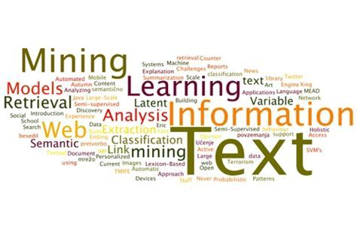
Why do we need it?
An essential part in all IR tasks

Slide 3
Agenda
Text Analysis (TA) and Information Retrieval (IR)
Simple text representation models
  Boolean model
  Bag-of-Words (BOW)
  Vector Space Model (VSM)
Advanced text representation models
  Integer Linear Programming (ILP)
  Fractional Linear Programming (LP)
  Sentence Graph Model

Slide 4

Questions…
… are more than welcome!
Please ask as we go!

Slide 5
Text Analysis and Information Retrieval
Input: text or collection of texts (corpus) in one or several languages
Goal: to discover and present knowledge hidden in textual content
Details depend on TA task, which could be:
  IR
  Summarization
  Sentiment Analysis
  … and many more …

Slide 6
Text Analysis Pipeline
User input and
constraints
Documents
Preprocessing
Preprocessing
UI model
Document
Model
Results

Slide 7
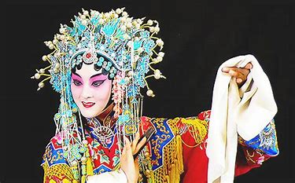

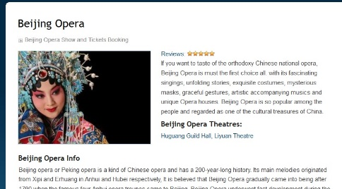
Why is it hard???
Example:
  I want to see traditional Chinese Opera
Query is not specific:
Where?
When?
What type of opera?
  A lot of information
  Not very organized
  In several languages

Slide 8


Text Modeling Dilemma
General model – works well for several tasks
Specific model – works very well for one task only
Breakthrough model – improves results for multiple tasks beyond state-of-the-art

Slide 9
Text Analysis Pipeline
User input and
constraints
Documents
Preprocessing
Preprocessing
UI model
Document
Model
Results

Slide 10
Text preprocessing (1)
Basic steps of text preprocessing
  Sentence splitting – separate text to sentences
  Tokenization – separate sentence to words
  Stemming or lemmatization – find root of each word
I have two cats. They are both fat. Original Text
[I] [have] [two] [cats] [.] After sentence splitting
[They] [are] [both] [fat] [.] and tokenization
[i] [hav] [two] [cat] [.] After stemming
[they] [ar] [both] [fat] [.]

Slide 11
Text preprocessing (2)
Additional steps of text preprocessing
  Name Entity Recognition
    Beijing is a name of a city
  Disambiguation
    ‘cat’ as an animal vs ‘cat’ the linux command
  Co-reference resolution
    What does a pronoun (it, she, he) refer to?
  MultiWord Expression recognition
    Russian Federation are two words used together
    Operating System, Information Retrieval, Data Mining
    …

Slide 12
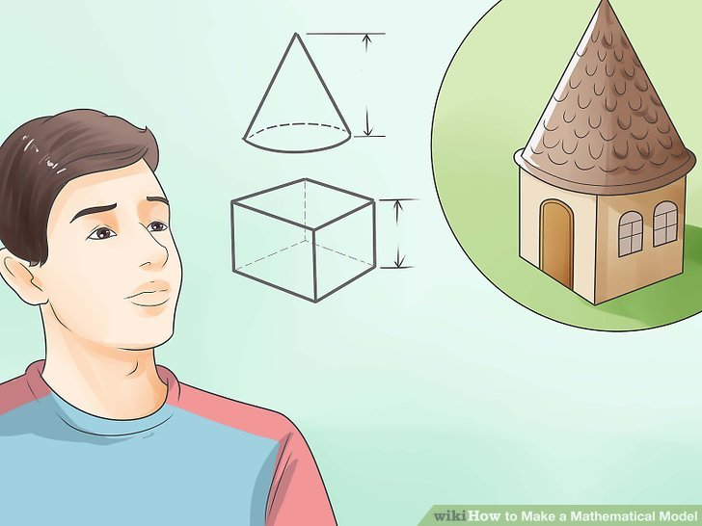
Text Modeling basics
First, we perform text pre-processing
Then we construct a mathematical model with objects we extract from text(s):
  words, tokens (aka terms), stems, sentences, named entities etc.

Slide 13
Boolean model (BM)
Lancaster, F.W.; Fayen, E.G. (1973)
Based on the notion of sets
Intended for the IR task – retrieve documents relevant to user query
Achieves good results for this tasks
  Documents are retrieved only if they satisfy Boolean conditions specified in the query
  Does not impose a ranking on retrieved documents
  Exact match

Slide 14
BM construction (1)
Term T appears
in sentence S
0
no
yes
1

Slide 15
BM construction (2)
Run pre-processing
Assign “0” or “1” weights to terms
  “0” represents “absence”: term isn’t in the document
  “1” represents “presence”: term is in the document
Build queries by combining terms with Boolean operators
  NOT, AND, OR,
IR system returns all documents that satisfy the query

Slide 16
Implied Boolean logic with keyword searching
Examples:
Query: I need information about cats.
Boolean logic: OR
Search: cats | felines
Query: I'm interested in dyslexia in adults.
Boolean logic: AND
Search: dyslexia +adults
Query: I'm interested in radiation, but not nuclear radiation.
Boolean logic: NOT
Search: radiation -nuclear
Query: I want to learn about cat behavior.
Boolean logic: OR, AND
Search: cats | felines +behavior

Slide 17
BM example
Document | I | have | two | cats | both | are | fat
I have two cats | 1 | 1 | 1 | 1 | 0 | 0 | 0
Both cats are fat | 0 | 0 | 0 | 1 | 1 | 1 | 1

Slide 18
Query example
Query: cats AND fat
Boolean query vector
Result:
I | have | two | cats | both | are | fat
0 | 0 | 0 | 1 | 0 | 0 | 1
Document | I | have | two | cats | both | are | fat
I have two cats | 1 | 1 | 1 | 1 | 0 | 0 | 0
Both cats are fat | 0 | 0 | 0 | 1 | 1 | 1 | 1

Slide 19

Boolean model
0-1 document/term matrix
Each document is represented by a binary vector ∈ {0,1}^{|V|}

Slide 20
Boolean operations
Based on concepts from logic: AND, OR, NOT
Order of operations (two conventions)
  NOT, AND, OR
  left to right
Normal forms
  Disjunctive Normal Form (DNF)
    (P AND Q) OR (Q AND NOT R) OR (P AND R)
  Conjunctive Normal Form (CNF)
    P AND (NOT Q OR R) AND (S OR NOT R)

Slide 21
Normal forms
Every Boolean query can be recast into:
Conjunctive Normal Form (CNF)
Q1 AND Q2 AND Q3 AND Q4
Each Q is a disjunct
(a OR b) AND (c OR d) AND (NOT a OR d)
Disjunctive Normal Form (DNF)
  Q1 OR Q2 OR Q3 OR Q4
  Each Q is a conjunct
(a AND b) OR (c AND d) OR (NOT a AND d)

Slide 22

Boolean search on the Internet
3 ways to use Boolean logic:
Full Boolean logic with the use of the logical operators
Implied Boolean logic with keyword searching
Predetermined language in a user fill-in template

Slide 23
Why IR with BM works?
Boolean operators approximate natural language
  Find documents about a good party that is not over
AND can discover relationships between concepts
  good party
OR can discover alternate terminology
  excellent party, wild party, etc.
NOT can discover alternate meanings
  Democratic party

Slide 24
Why IR with BM fails?
Natural language is way more complex
AND “discovers” nonexistent relationships
  Terms in different sentences, paragraphs, …
Guessing terminology for OR is hard
  good, nice, excellent, outstanding, awesome, …
Guessing terms to exclude is even harder!
  democratic party, party to a lawsuit, third party, …

Slide 25
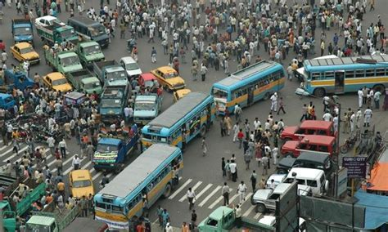
Strengths and weaknesses
Strengths
  Precise, if you know the right strategies
  Precise, if you have an idea of what you’re looking for
  Efficient for the computer
Weaknesses
  Boolean logic insufficient to capture the richness of language
  No order! All documents in the result set are considered “equally good”
  What about partial matches? Documents that “don’t quite match” the query may be useful also

Slide 26
Bigger collections
Consider N = 1M documents, each with about 1K terms.
Avg 6 bytes/term including spaces/punctuation
  6GB of data in the documents. (1M*1K*6)
Say there are m = 500K distinct terms among these.

Slide 27
Can’t build the matrix
500K x 1M matrix has half-a-trillion 0’s and 1’s.
But it has no more than one billion 1’s (1K*1M).
  matrix is extremely sparse.
What’s a better representation?
  We only record the 1 positions.
Why?
0.2%

Slide 28
Inverted index
For each term T, we must store a list of all documents that contain T.
Do we use an array or a list for this?
Brutus
2
4
8
16
32
64
128
Calpurnia
1
2
3
5
8
13
21
34
Caesar
13
16
What happens if the word Caesar is added to document 14?

Slide 29
Inverted index
Linked lists generally preferred to arrays
  Dynamic space allocation
  Insertion of terms into documents easy
  Space overhead of pointers
Posting
Brutus
2
4
8
16
32
64
128
Calpurnia
1
2
3
5
8
13
21
34
Caesar
13
16
Dictionary
Postings lists
Sorted by docID (more later on why).

Slide 30





Inverted index construction
Documents to
be indexed.
Friends, Romans, countrymen.
Regular expression
Tokenizer
Token stream.
Friends
Romans
Countrymen
More on
these later
Linguistic modules
Modified tokens.
friend
roman
countryman
Indexer
friend
2
4
roman
1
2
Inverted index.
countryman
13
16

Slide 31
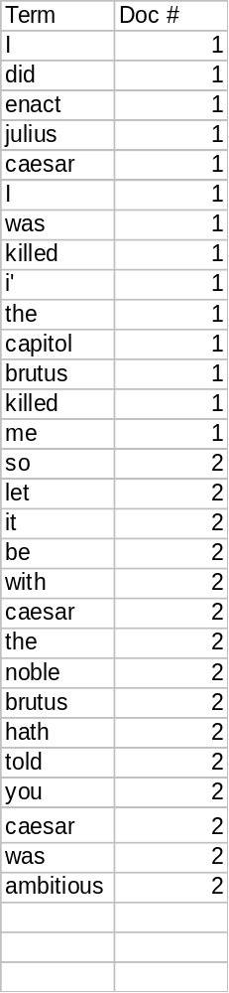
Indexer steps
Sequence of (Modified token, Document ID) pairs.
Doc 1
Doc 2
I did enact Julius
Caesar I was killed
i' the Capitol;
Brutus killed me.
So let it be with
Caesar. The noble
Brutus hath told you
Caesar was ambitious

Slide 32

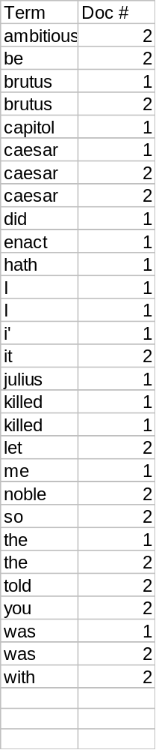
Sort by terms.
Core indexing step.

Slide 33


Multiple term entries in a single document are merged.
Frequency information is added.
Why frequency?
Will discuss later.

Slide 34
Where do we pay in storage?
Sec. 1.2
Lists of docIDs
Terms and counts
Later in the course:
How do we index efficiently?
How much storage do we need?
Pointers

Slide 35
The index we just built
Today’s focus
How do we process a query?
  Later - what kinds of queries can we process?

Slide 36
Query processing: AND
Consider processing the query:
  Brutus AND Caesar
  Locate Brutus in the Dictionary;
    Retrieve its postings.
  Locate Caesar in the Dictionary;
    Retrieve its postings.
  “Merge” the two postings:
2
4
8
16
32
64
128
Brutus
1
2
3
5
8
13
21
34
Caesar

Slide 37
The merge
Walk through the two postings simultaneously, in time linear in the total number of postings entries
2
2
4
4
8
8
16
16
32
64
128
32
64
128
Brutus
2
8
1
Caesar
1
2
2
3
5
5
8
8
13
13
21
21
34
3
34
If the list lengths are x and y, the merge takes O(x+y)
operations.
Crucial: postings sorted by docID.

Slide 38

Intersecting two postings lists
(a “merge” algorithm)

Slide 39
Boolean queries: Exact match
The Boolean Retrieval model is being able to ask a query that is a Boolean expression:
  Boolean Queries are queries using AND, OR and NOT to join query terms
    Views each document as a set of words
    Is precise: document matches condition or not.
Primary commercial retrieval tool for 3 decades.
Professional searchers (e.g., lawyers) still like Boolean queries:
  You know exactly what you’re getting.
  Search systems: Email, library catalog

Slide 40
Boolean queries:
More general merges
Exercise: Adapt the merge for the queries:
Brutus AND NOT Caesar
Brutus OR NOT Caesar
Can we still run through the merge in time O(x+y)?
What can we achieve?

Slide 41
Merging
What about an arbitrary Boolean formula?
(Brutus OR Caesar) AND NOT
(Antony OR Cleopatra)
Can we always merge in “linear” time?
  Linear in what?
Can we do better?

Slide 42
Query optimization
What is the best order for query processing?
Consider a query that is an AND of t terms.
For each of the t terms, get its postings, then AND them together.
Brutus
2
4
8
16
32
64
128
Calpurnia
1
2
3
5
8
16
21
34
Caesar
13
16
Query: Brutus AND Calpurnia AND Caesar

Slide 43
Query optimization example
Process in order of increasing frequency:
  start with smallest set, then keep cutting further.
This is why we kept
freq in dictionary
Brutus
2
4
8
16
32
64
128
Calpurnia
1
2
3
5
8
13
21
34
Caesar
13
16
Execute the query as (Caesar AND Brutus) AND Calpurnia.

Slide 44
More general optimization
e.g., (madding OR crowd) AND (ignoble OR strife)
Get freq’s for all terms.
Estimate the size of each OR by the sum of its freq’s (conservative).
Process in increasing order of OR sizes.

Slide 45
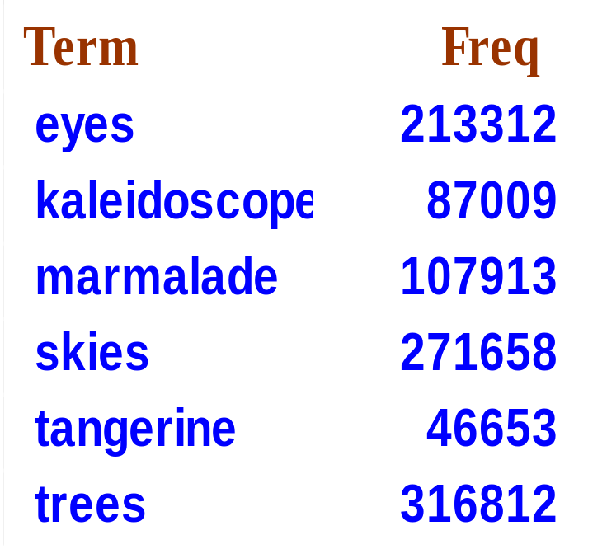
Exercise
Recommend a query processing order for
(tangerine OR trees) AND
(marmalade OR skies) AND
(kaleidoscope OR eyes)

Slide 46
More efficient index

Slide 47


Bag-of-Words Model (BoW)
Every document is a multiset of its terms
  I have a black cat without white spots =
  {I, have, а, black, white, without, cat, spots}
No word order in sentence
  I have a black cat without white spots =
  I have a white cat without black spots
=

Slide 48

Problem with Boolean search: feast or famine
Boolean queries often result in either too few (=0) or too many (1000s) results.
It takes skill to come up with a query that produces a manageable number of hits.
Idea: with a ranked list of documents it does not matter how large the retrieved set is.

Slide 49
Scoring as the basis of ranked IR
With a ranked list of documents it does not matter how large the retrieved set is.
We wish to return in order the documents most likely to be useful to the searcher
How can we rank-order the documents in the collection with respect to a query?
Assign a score – say in [0, 1] – to each document

Slide 50
Query-document matching scores
One term query = ‘cat’
The more frequent the query term in the document, the higher the score (should be)
score = 0
…cat…
score > 0
cat…
…cat
score >> 0

Slide 51
Jaccard coefficient
A commonly used measure of overlap of two sets A and B
jaccard(A,B) = |A ∩ B| / |A ∪ B|
jaccard(A,A) = 1
jaccard(A,B) = 0 if A ∩ B = 0
Always assigns a number between 0 and 1.
low similarity
high similarity
A ∩ B
A ∩ B

Slide 52
Jaccard coefficient: Scoring example
What is the query-document match score that the Jaccard coefficient computes for each of the two documents below?
Query: ides of march
Document 1: Caesar died in march
  Jaccard (Query, Document 1) = 1/6
Document 2: the long march
  Jaccard (Query, Document 2) = 1/5

Slide 53
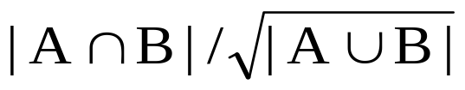
Issues with Jaccard for scoring
It doesn’t consider term frequency (how many times a term occurs in a document)
Rare terms in a collection are more informative than frequent terms. Jaccard doesn’t consider this information
We need a more sophisticated way of normalizing for length
we’ll use
. . . instead of |A ∩ B|/|A ∪ B| for length normalization.

Slide 54
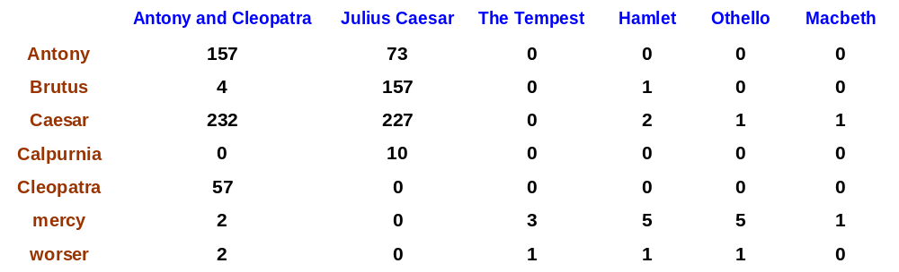
BoW
Term-document count matrices
Consider the number of occurrences of a term in a document:
  Each document is a count vector in ℕ^{v}: a column below

Slide 55
BoW
Strengths and weaknesses
Strengths
Documents can be ranked by their Jaccard coefficient in comparison to the query
Sentences can be ranked by their Jaccard coefficient when compared the whole document
Similar sentences can be discovered using Jaccard coefficient
Weaknesses
Summarization remains an optimization problem and requires additional algorithm(s) to solve
Words with highest term count will probably be:
  the, to, be, of, and (for English)
Word order in a sentence is not taken into account

Slide 56
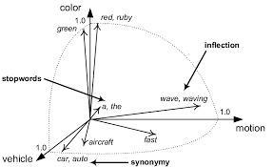
Vector Space Model with tf-idf
G. Salton , A. Wong , C. S. Yang (1975)
Texts (documents, sentences, queries) are represented by real-valued vectors of their terms
Vector values take into account both term frequency and inversed document frequency
  terms that distinguish the documents have higher weights
Similarity between texts is computed as cosine similarity between their vectors

Slide 57
Term frequency tf
The term frequency tf_{t,d} of term t in document d = the number of times that t occurs in d.
Raw term frequency is not what we want:
  A document with 10 occurrences of the term is more relevant than a document with one occurrence of the term.
  But not 10 times more relevant!
Relevance does not increase proportionally with term frequency

Slide 58
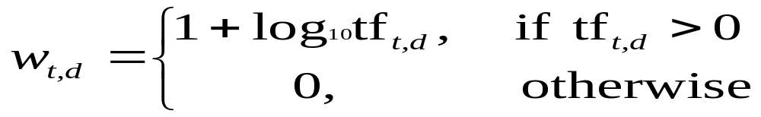

Log-frequency weighting
The log frequency weight of term t in d is
0 → 0, 1 → 1, 2 → 1.3, 10 → 2, 1000 → 4, etc.
Score for a document-query pair: sum over terms t in both q and d:
score
The score is 0 if none of the query terms is present in the document.

Slide 59
Term frequency (example)
…dog…
dog…
D1
tf_{cat,D1}=0
w_{cat,D1}=0
D2
…cat…
tf_{cat,D2}=1
w_{cat,D2}=0+1=1
cat…
D3
…cat
tf_{cat,D3}=2
w_{cat,D3}~0.301+1=1.301
cat…cat
D4
cat…cat
tf_{cat,D4}=4
w_{cat,D4}~0.602+1=1.602

Slide 60
Document frequency (1)
Rare terms are more informative than frequent terms
  so-called stop words (the, is, at)
Consider a term in the query that is rare in the collection (e.g., acrocentric)
→ We want a high weight for rare terms like acrocentric.

Slide 61
Rare and frequent terms (example)
…dog…
dog…
D1
more important
D2
…cat…
cat…
D3
…cat
less important
cat…cat
D4
cat…cat

Slide 62
Document frequency (2)
Consider a query term that is frequent in the collection (e.g., high, increase, line)
A document containing such a term is more likely to be relevant than a document that doesn’t, but it’s not a sure indicator of relevance.

Slide 63
Document frequency (3)
→ For frequent terms, we want positive weights for words like high, increase, and line, but lower weights than for rare terms.
We will use document frequency (df) to capture this in the score.
df (≤ N) is the number of documents that contain the term

Slide 64
df (example)
…dog…
dog…
D1
df_{dog}=1
D2
…cat…
cat…
D3
…cat
df_{cat}=3
cat…cat
D4
cat…cat

Slide 65
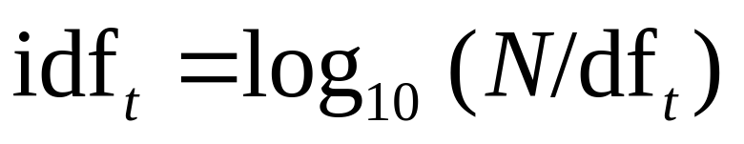
idf weight
df_{t} is the document frequency of t: the number of documents that contain t
  df is a measure of the informativeness of t
We define the idf (inverse document frequency) of t by
  We use log N/df_{t} instead of N/df_{t} to “dampen” the effect of idf.
Will turn out the base of the log is immaterial.

Slide 66
idf (example)
…dog…
dog…
D1
df_{dog}=1
idf_{dog}=log₁₀(4/1)~0.602/1
=0.602
D2
…cat…
cat…
idf_{cat}=log₁₀(4/3)~0.125
D3
…cat
df_{cat}=3
cat…cat
D4
cat…cat

Slide 67
idf (larger )example, N= 1 million
term | df_{t} | idf_{t}
calpurnia | 1 | 6
animal | 100 | 4
sunday | 1,000 | 3
fly | 10,000 | 2
under | 100,000 | 1
the | 1,000,000 | 0
There is one idf value for each term t in a collection.

Slide 68
Collection vs. Document frequency
The collection frequency of t is the number of occurrences of t in the collection, counting multiple occurrences.
Example:
Which word should get a higher weight?
Word | Collection frequency | Document frequency
insurance | 10440 | 3997
try | 10422 | 8760

Slide 69
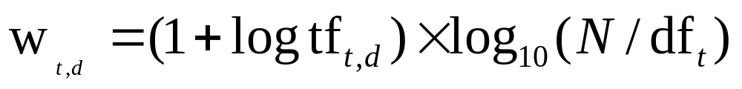
tf-idf weighting
The tf-idf weight of a term is the product of its tf weight and its idf weight.
Best known weighting scheme in IR&NLP
Increases with the number of occurrences within a document
Increases with the rarity of the term in the collection

Slide 70


tf-idf (example)
…dog…
dog…
D1
tf-df_{dog,D1}=w_{dog,D1}*idf_{dog}=1.301*0.602~0.608
D2
…cat…
tf-df_{cat,D2}=w_{cat,D2}*idf_{cat}=1*0.125=0.125
cat…
D3
…cat
tf-df_{cat,D3}=w_{cat,D3}*idf_{cat}=1.301*0.125~0.163
cat…cat
D4
tf-df_{cat,D4}=w_{cat,D4}*idf_{cat}=1.602*0.125~0.401
cat…cat

Slide 71

Matrices: boolean → count → tf-idf
Each document is now represented by a real-valued vector of tf-idf weights ∈ R^{|V|}

Slide 72
Matrices
Boolean
Term counts
Normalized term counts
Doc | cat | dog
D1 | 0 | 1
D2 | 1 | 0
D3 | 1 | 0
D4 | 1 | 0
Doc | cat | dog
D1 | 0 | 2
D2 | 1 | 0
D3 | 2 | 0
D4 | 4 | 0
Doc | Cat | dog
D1 | 0 | 1.301
D2 | 1 | 0
D3 | 1.301 | 0
D4 | 1.602 | 0
tf-idf
Doc | cat | dog
D1 | 0 | 0.608
D2 | 0.125 | 0
D3 | 0.163 | 0
D4 | 0.401 | 0
Each document is now represented
by a real-valued vector
of tf-idf weights

Slide 73
Documents as vectors
So we have a |V|-dimensional vector space
Terms are axes of the space
Documents are points or vectors in this space
Very high-dimensional: hundreds of millions of dimensions when you apply this to a web search engine
This is a very sparse vector - most entries are zero.

Slide 74
Queries as vectors for the IR task
Key idea 1: Do the same for queries: represent them as vectors in the space
Key idea 2: Rank documents according to their proximity to the query in this space
proximity = similarity of vectors
≈ inverse of distance
Ranks more relevant documents higher than less relevant documents

Slide 75
Vector similarity (intuition)
Doc | cat | dog
D1 | 0 | 0.608
D2 | 0.125 | 0
D3 | 0.163 | 0
D4 | 0.401 | 0
those vectors
are very
similar
those vectors
are very
different

Slide 76

Why distance is a bad idea
The Euclidean distance between q
and d₂ is large even though the
distribution of terms in the query q and the distribution of
terms in the document d₂ are
very similar.

Slide 77
Use angle instead of distance
Thought experiment: take a document d and append it to itself. Call this document d′.
“Semantically” d and d′ have the same content
The Euclidean distance between the two documents can be quite large
The angle between the two documents is 0, corresponding to maximal similarity.
Key idea: Rank documents according to angle with query.

Slide 78
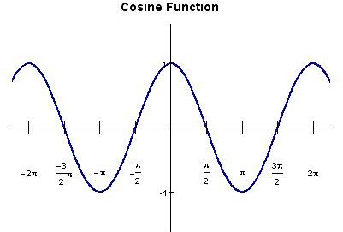



From angles to cosines
The following two notions are equivalent.
  Rank documents in decreasing order of the angle between query and document
  Rank documents in increasing order of cosine(query,document)
Cosine is a monotonically decreasing function for the interval [0º, 180º]
θ | 0º | 30º | 45º | 60º | 90º | 180º | 270º
cos θ | 1 |  |  |  | 0 | -1 | 0

Slide 79
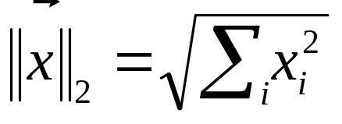
Length normalization
A vector can be (length-) normalized by dividing each of its components by its length – for this we use the L₂ norm:
Dividing a vector by its L₂ norm makes it a unit (length) vector
Effect on the two documents d and d′ (d appended to itself) from earlier slide: they have identical vectors after length-normalization.

Slide 80
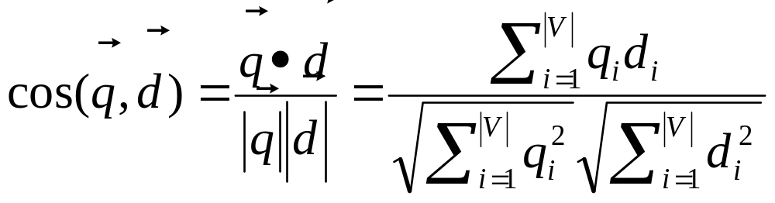
cosine(query,document)
Dot product
Unit vectors
q_{i} is the tf-idf weight of term i in the query
d_{i} is the tf-idf weight of term i in the document
cos(q,d) = the cosine similarity of q and d … =
the cosine of the angle between q and d.

Slide 81
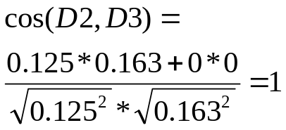
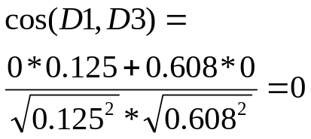
Cosine similarity (without normalization)
Doc | cat | dog
D1 | 0 | 0.608
D2 | 0.125 | 0
D3 | 0.163 | 0
D4 | 0.401 | 0

Slide 82
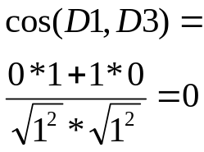
Cosine similarity (normalized)
Doc | cat | dog | Vector length
D1 | 0 | 0.608 | 0.608
D2 | 0.125 | 0 | 0.125
D3 | 0.163 | 0 | 0.163
D4 | 0.401 | 0 | 0.401s
Doc | cat | dog
D1 | 0 | 1
D2 | 1 | 0
D3 | 1 | 0
D4 | 1 | 0
normalize

Slide 83
Cosine similarity amongst 3 documents, using log freq. weighting vectors
How similar are
the novels
SaS: Sense and
Sensibility
PaP: Pride and
Prejudice, and
WH: Wuthering
Heights
?
term | SaS | PaP | WH
affection | 115 | 58 | 20
jealous | 10 | 7 | 11
gossip | 2 | 0 | 6
wuthering | 0 | 0 | 38
Term frequencies (counts)

Slide 84
3 documents example contd.
Log frequency weighting
After normalization
1+log 115
3.06/sqrt(3.06^2+2^2+1.3^2)
term | SaS | PaP | WH
affection | 3.06 | 2.76 | 2.30
jealous | 2.00 | 1.85 | 2.04
gossip | 1.30 | 0 | 1.78
wuthering | 0 | 0 | 2.58
term | SaS | PaP | WH
affection | 0.789 | 0.832 | 0.524
jealous | 0.515 | 0.555 | 0.465
gossip | 0.335 | 0 | 0.405
wuthering | 0 | 0 | 0.588
cos(SaS,PaP) ≈
0.789 ∗ 0.832 + 0.515 ∗ 0.555 + 0.335 ∗ 0.0 + 0.0 ∗ 0.0
≈ 0.94
cos(SaS,WH) ≈ 0.79
cos(PaP,WH) ≈ 0.69
Why do we have cos(SaS,PaP) > cos(SaS,WH)?

Slide 85
3 documents example, cont.
Log frequency weighting
idf weighting
1+log 115
log 30/5
term | SaS | PaP | WH
affection | 3.06 | 2.76 | 2.30
jealous | 2.00 | 1.85 | 2.04
gossip | 1.30 | 0 | 1.78
wuthering | 0 | 0 | 2.58
term | df | idf
affection | 5 | 0.78
jealous | 6 | 0.70
gossip | 3 | 1.00
wuthering | 2 | 1.18

Slide 86
3 documents example, cont.
Tf-idf weighting
After normalization
3.06*0.78
2.38/sqrt(2.38^2+1.4^2+1.3^2)
term | SaS | PaP | WH
affection | 2.38 | 2.15 | 1.79
jealous | 1.40 | 1.29 | 1.43
gossip | 1.30 | 0.00 | 1.78
wuthering | 0.00 | 0.00 | 3.03
term | SaS | PaP | WH
affection | 0.78 | 0.86 | 0.43
jealous | 0.46 | 0.51 | 0.34
gossip | 0.43 | 0.00 | 0.42
wuthering | 0.00 | 0.00 | 0.72
cos(SaS,PaP) ≈
0.78 ∗ 0.86 + 0.46 ∗ 0.51 + 0.43 ∗ 0 + 0 ∗ 0
≈ 0.9
cos(SaS,WH) ≈ 0.67
cos(PaP,WH) ≈ 0.54

Slide 87
VSM - summary
Vector space model - is an algebraic model for representing text documents as vectors of identifiers, such as, for example, index terms.
A document is represented as a vector. Each dimension corresponds to a separate term. If a term occurs in the document, its value in the vector is non-zero.
  There are several different ways of computing these values (term weights).
  One of the best known schemes is tf-idf weighting.

Slide 88
Summary, cont.
The definition of term depends on the application.
  Typically terms are single words, keywords, or longer phrases.
  The dimensionality of the vector is the number of terms in the corpus .
  Example: If the words are chosen to be the terms, the dimensionality = number of distinct words occurring in the corpus.

Slide 89
VSM weaknesses
Long documents are poorly represented because they have poor similarity values (a small scalar product and a large dimensionality)
Semantic sensitivity; documents with similar context but different term vocabulary won't be associated, resulting in a "false negative match".
The order in which the terms appear in the document is lost in the vector space representation.

Slide 90
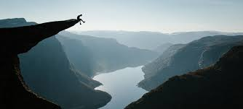
Complex TA tasks
Summarization – select/write a short text of predefined length that conveys the contents of a document
Most summarization approaches build their text representations on top of VSM (good for multilinguality)
Let’s find out how!

Slide 91
Integer Linear Programming Model
R. Mcdonald (2007)
Treats summarization as an optimization problem
Text is represented as a set of linear inequalities with 0-1 value variables
Selects a set of sentences that compose a summary
Uses maximal coverage-minimal redundancy principle:
  Best summary covers most of the information in text but does not contain repeated information

Slide 92
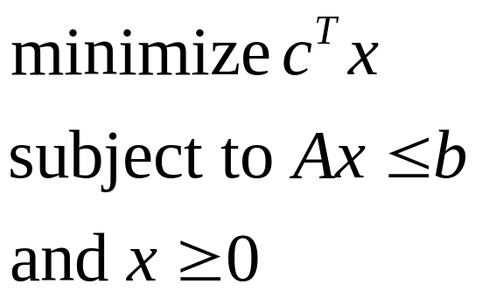
What is Linear Programming (LP)?
Goal of LP is to solve a system of linear equations while minimizing a target function:
where x is a vector of variables, c and b are known
vectors of values, and A is a matrix.

Slide 93
LP types
x accepts rational values
x accepts 0-1 values
Can be solved in polynomial time
is called Integer Linear Programming.
It is NP-hard

Slide 94
ILP model parameters
Relevance measure Rel(i) for every sentence S_{i}
  computed as cosine similarity to the whole document
Redundancy measure Red(i,j) for every pair of sentences S_{i}, S_{j}
  computed as cosine similarity between the sentences
Length l(i) of sentence S_{i}
Maximal length W of the summary

Slide 95
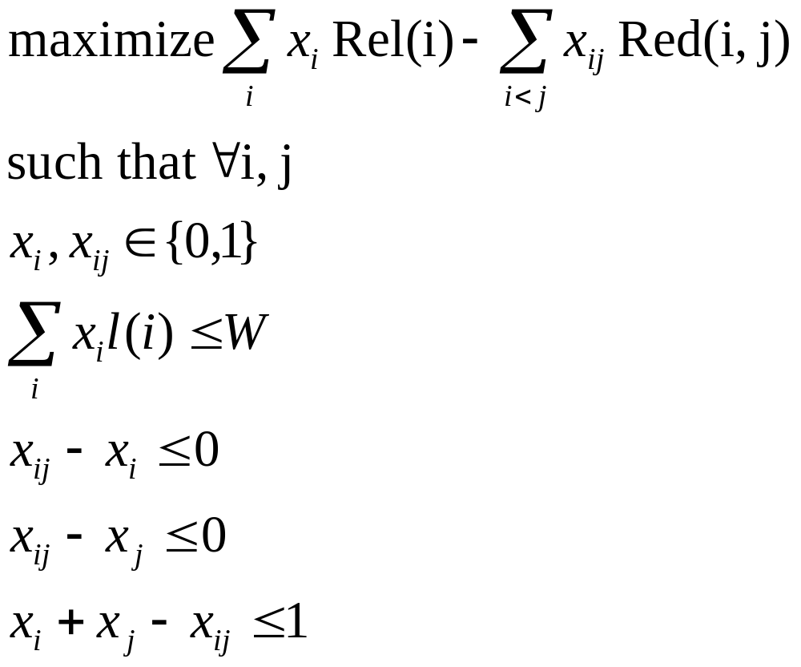
ILP model formulation
sentence i
pair of sentences i,j
ILP
summary length is bounded by W
keep both sentences only if they
are not redundant

Slide 96
ILP: strengths and weaknesses
Strengths
  Can be adapted to compressive summarization task
  Runs in reasonable time with solvers such as CPLEX
Weaknesses
  The ILP is NP-hard
  Adding constraints other than summary length requires re-writing of the whole model
  Relies on precomputed cosine similarities

Slide 97
Polytope (fractional LP) Model
M. Litvak, N. Vanetik (2013)
Treats summarization as an optimization problem
LP variables represent terms
Can use maximal coverage-minimal redundancy principle but is not bound by it
All constraints are represented as inequalities
Fractional LP is solved in polynomial time

Slide 98
Polytope model parameters
Extractive summarization – select a subset of sentences
Maximal and minimal word lengths W_{min}, W_{max} of the summary
Maximal and minimal number of different terns T_{min}, T_{max} of the summary
Uses sentence-term count matrix A=(a_{ij}) (hello, BoW model!), can use tf-idf as well

Slide 99
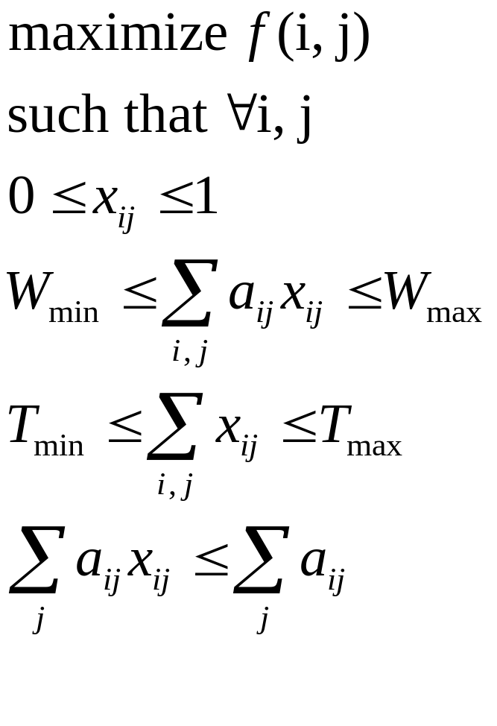
Polytope model formulation
objective function
term j in sentence i
fractional LP
summary length is
bounded by W_{max}
and W_{min}
polytope boundaries – represent
all possible summaries

Slide 100
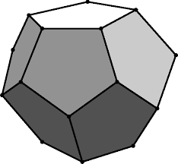
Polytope as a picture
Polytope=convex polyhedron
Sentence subset closest to
optimal solution = summarys
Objective function
Optimal solution
Facets=sentences and constraints

Slide 101
Polytope: strengths and weaknesses
Strengths
  Naturally extends to compressive summarization task
  Runs in polynomial time
  Different constraints and weighting schemes for terms can be used within the model (tf-idf, n-gram count etc.)
Weaknesses
  The optimal solution is not an integer solution, and additional (polynomial) procedure to locate summary sentence needs to be applied

Slide 102
Document graph model
Mihalcea, R., and Tarau, P. (2004)
Every sentence is a graph node
There is an edge between every pair of sentences
Weight of an edge is cosine distance between VSM vectors of sentences
Optimization algorithm (the famous TextRank)
  Run a variation of PageRank on document graph
  Get a rank of sentences
  Top ranked sentences compose a summary

Slide 103
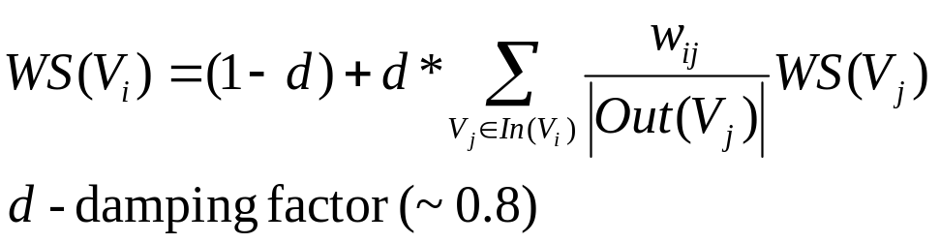
TextRank as a picture
Sentence V_{i}
W_{ij}=cos(V_{i}, V_{j})
Sentence V_{j}
Rank of a node

Slide 104
Document graph model
Strengths
  Works very well for summarization, keyword extraction, query-based summarization
Weaknesses
  Computationally heavy for large texts because of vector sizes

Slide 105
What else is outwhere?
Neural networks and Deep Learning (rNN, LSTM etc.)
Word embedding
  words or phrases from the vocabulary are mapped to vectors of real numbers.
  Methods to generate this mapping include neural networks, dimensionality reduction on the word co-occurrence matrix

Slide 106
References
Lancaster, F. W., and E. G. Fayen. "Information Retrieval On-Line, Melville Publ." Co., Los Angeles, Calif (1973): 15.
Salton, Gerard, Anita Wong, and Chung-Shu Yang. "A vector space model for automatic indexing." Communications of the ACM 18, no. 11 (1975): 613-620.
McDonald, R., 2007, April. A study of global inference algorithms in multi-document summarization. In European Conference on Information Retrieval (pp. 557-564). Springer, Berlin, Heidelberg.
Litvak, Marina, and Natalia Vanetik. "Multilingual multi-document summarization with poly2." In Proceedings of the MultiLing 2013 Workshop on Multilingual Multi-document Summarization, pp. 45-49. 2013.
Mihalcea, Rada, and Paul Tarau. "Textrank: Bringing order into text." In Proceedings of the 2004 conference on empirical methods in natural language processing. 2004.

